Slide 1
Paper Introduction SIGGRAPH 2025
Presenter: Jun Date: Aug. 27

Slide 2
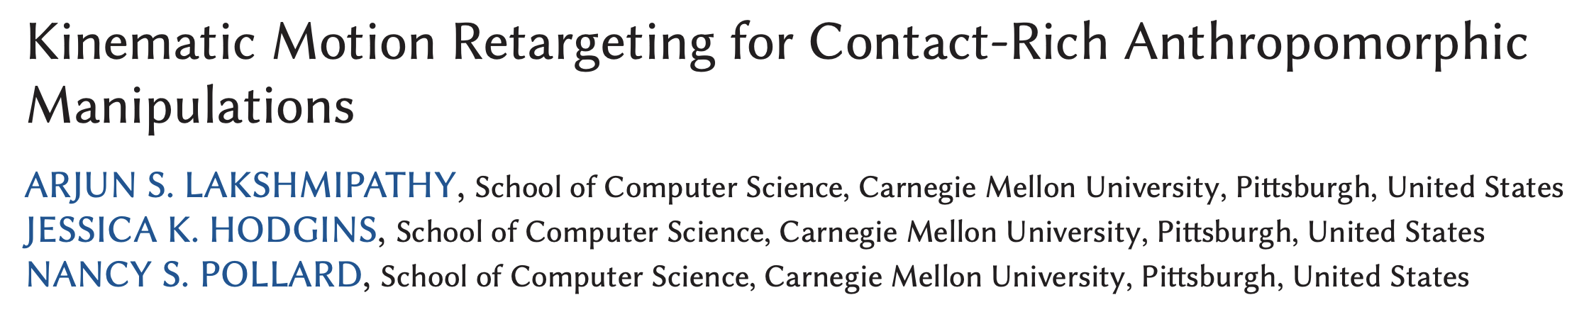
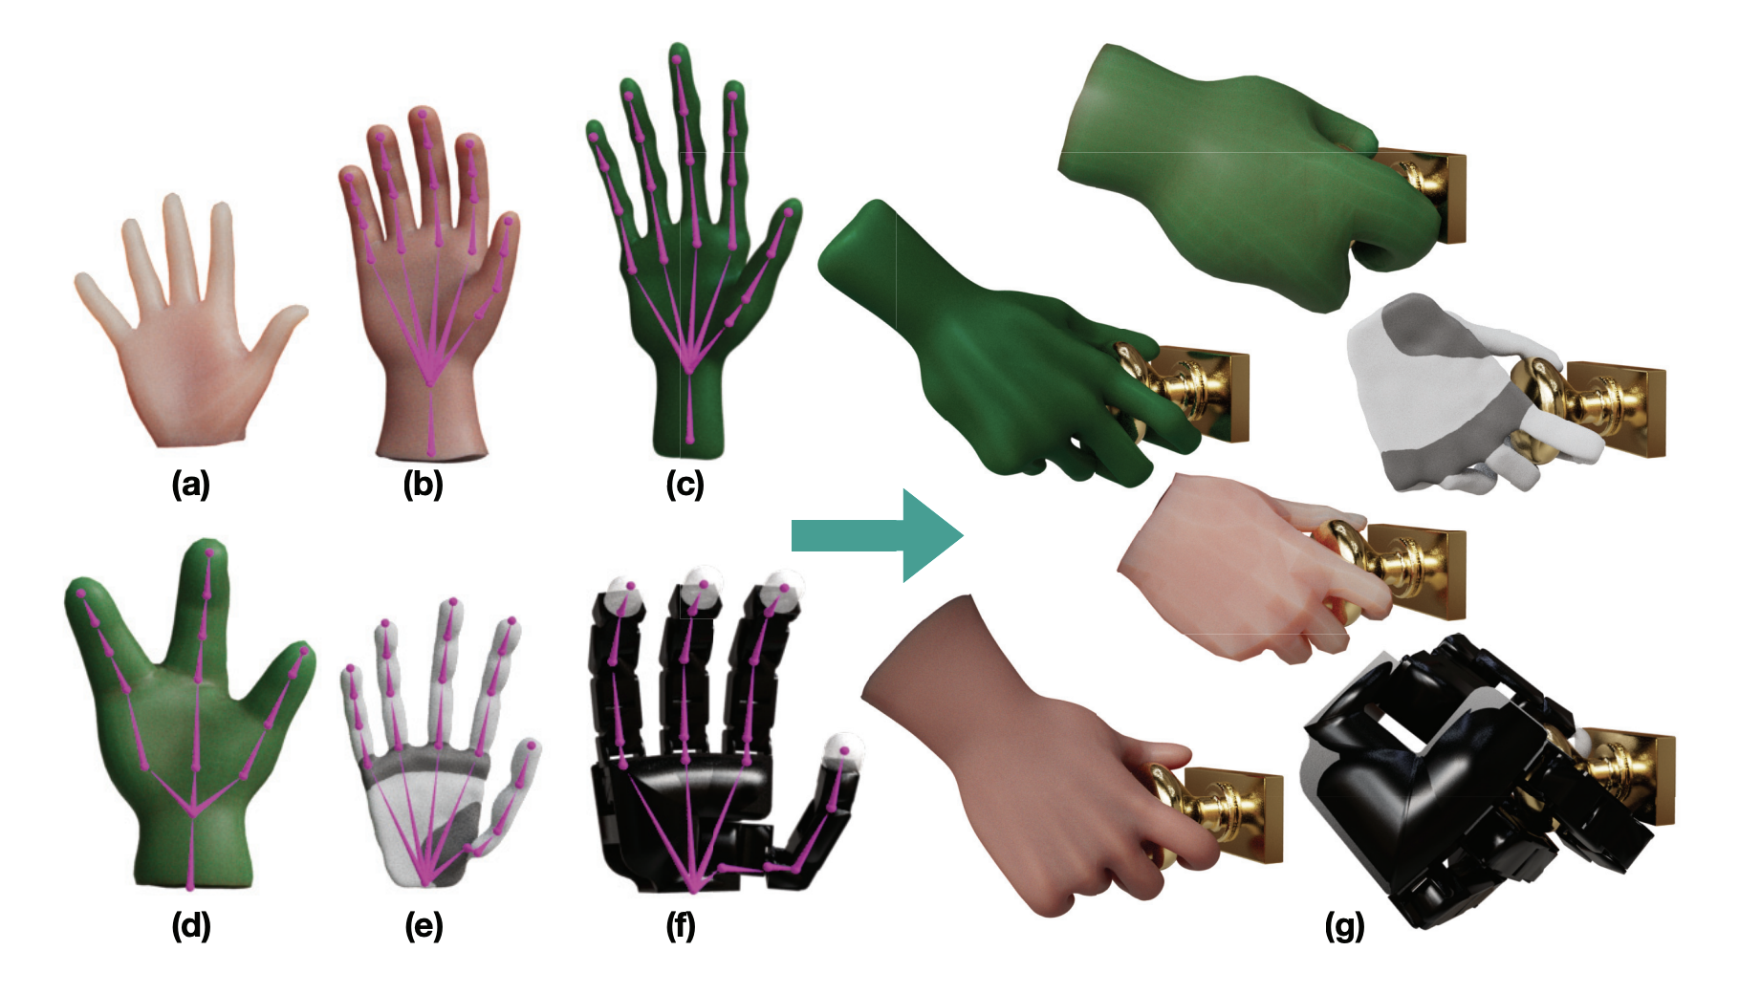
Task:
retargeting human hand-object manipulations
Application:
Animation
Robot transfer learning

Slide 3
Motion Retargeting: Existing Approaches
Kinematic Retargeting:
Joint Angle Mapping: Directly map source joint rotations to target skeleton
Keypoint-based inverse kinematics (IK): Match keypoints using IK solvers
Keyvector distances: Preserve relative vectors between keypoints across skeletons
Physics-based:
Physics simulation optimization: Use dynamics or RL to refine retargeted trajectories
Different Challenges: Full-body motion vs Hand manipulation
Full-body motions: Only a few contact points are sufficient (e.g., foot–ground)
Hand manipulations: Require rich and time-varying contact areas across fingers and palm

Slide 4
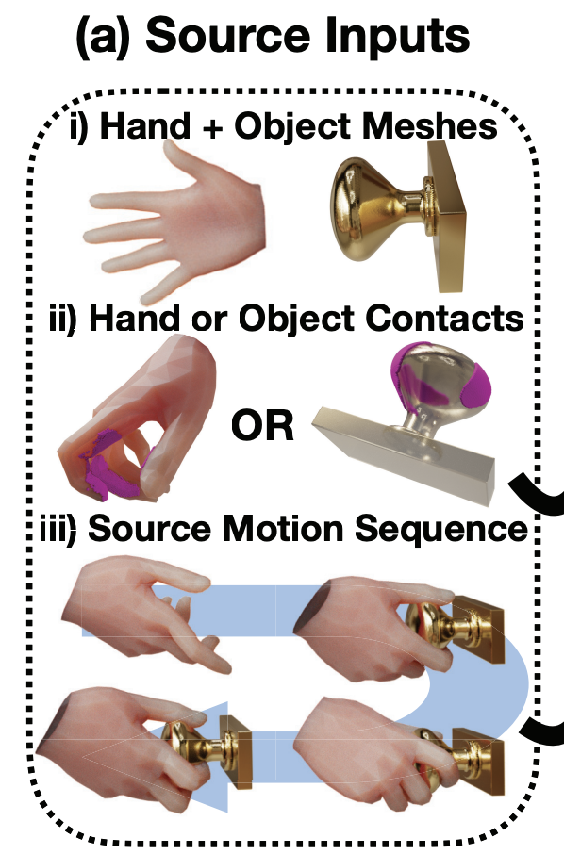
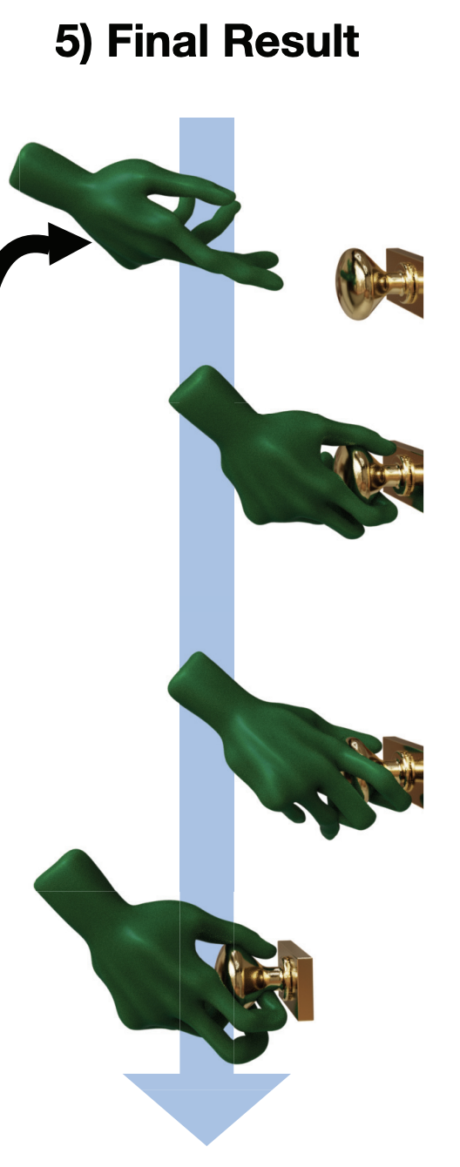
Problem Definition
Inputs:
Accurate meshes of source hand and object
Per-frame contact annotations (points or patches)
Complete motion sequence
Output:
Target hand motion trajectory
Challenges:
Geometric diversity: different finger counts, proportions, DOFs
Contact complexity: rich and time-varying contacts (pre-grasp → pickup → reorientation → release)

Slide 5
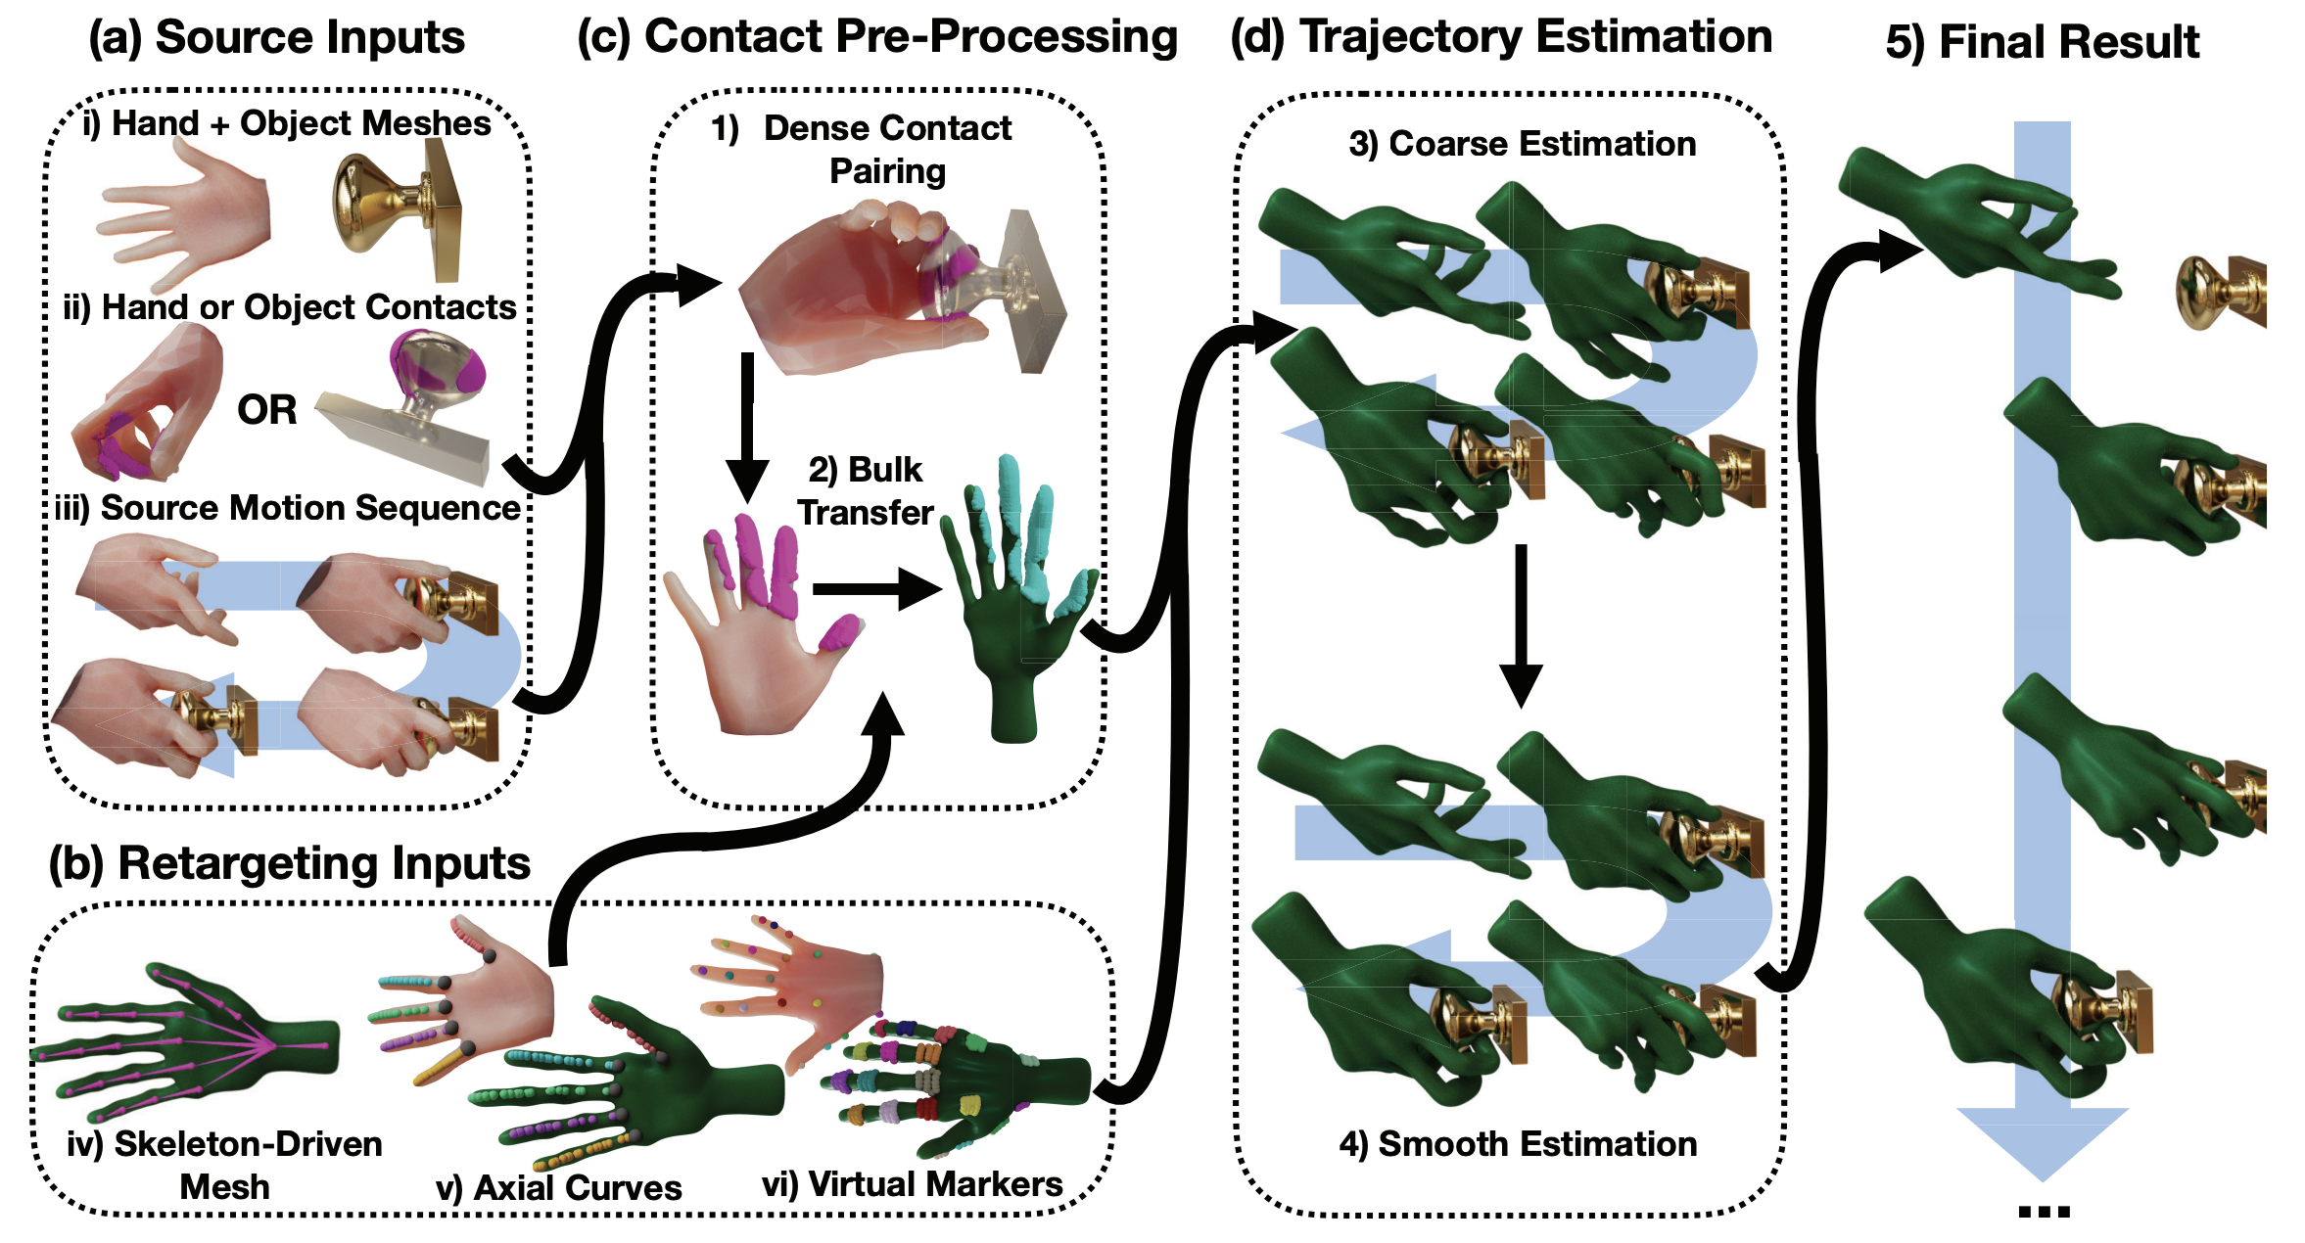
Pipeline
Key Idea:
Use contact areas (not just joints or sparse keypoints) as the retargeting medium
Nonisometric mapping between hands
Leverage virtual markers + axial curves for reliable mapping

Slide 6
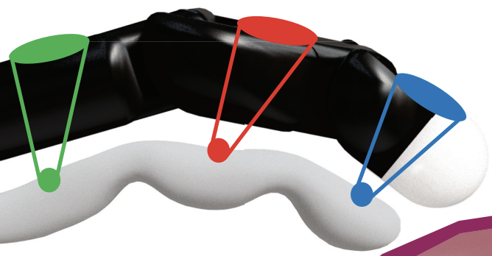
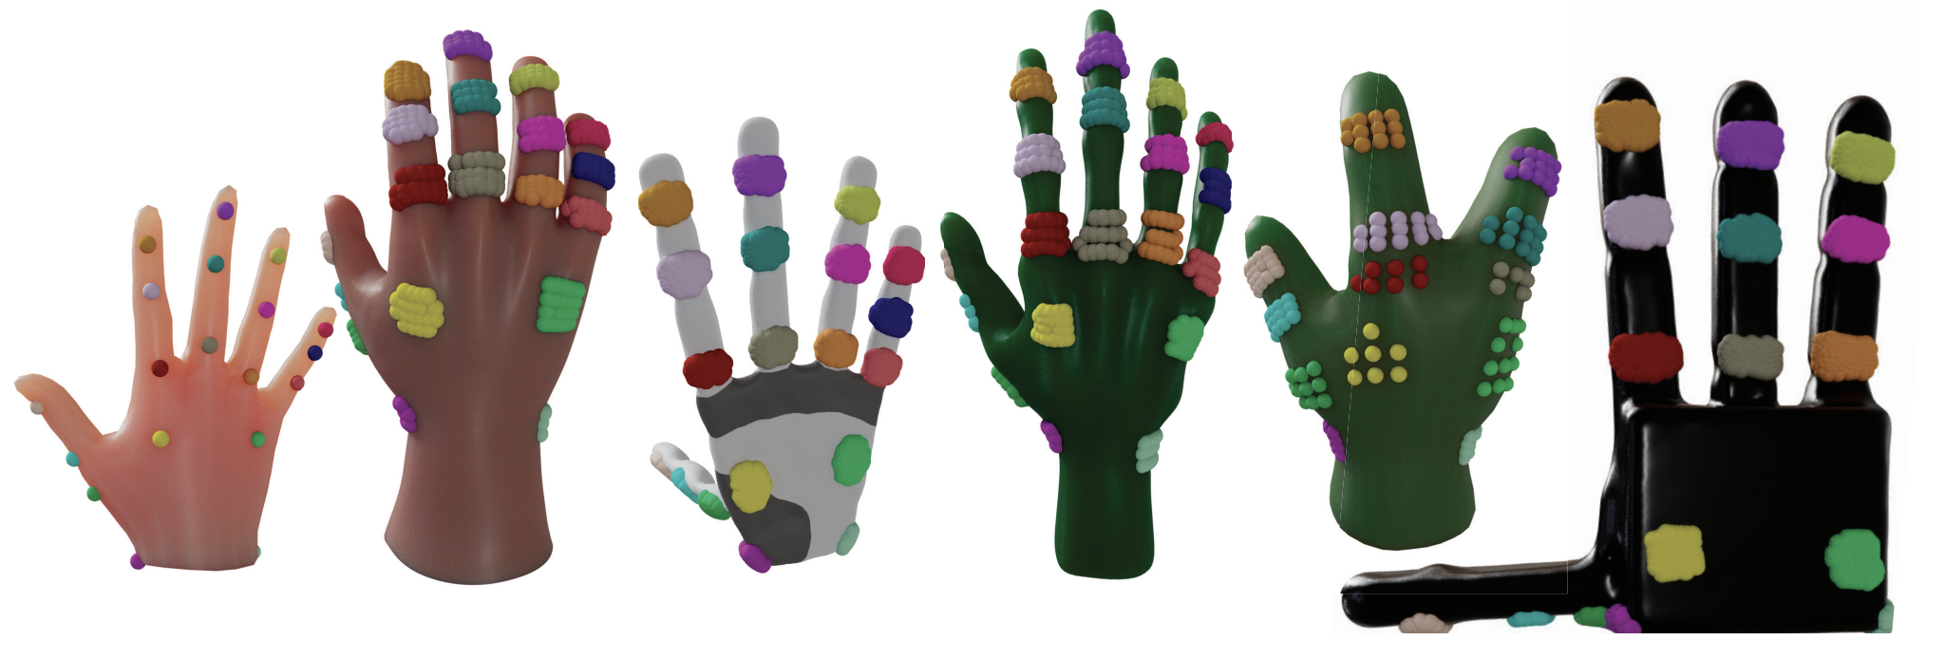
Hand Shape Matching
Target
Virtual Marker Alignment
Contact Alignment
Source
Virtual Marker Alignment
Single-point (Source) vs. Area-based (Target)
Source hand: standardized → single-point clear
Target hands: diverse → area robust
Virtual markers (artist-provided)

Slide 7
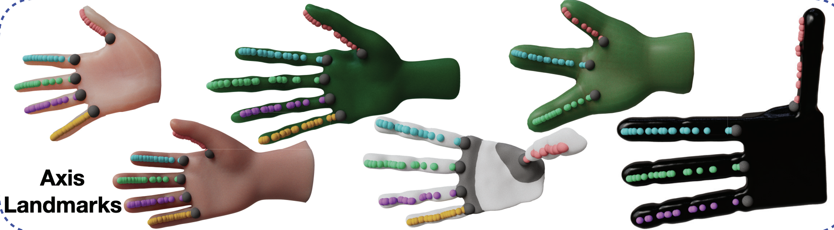
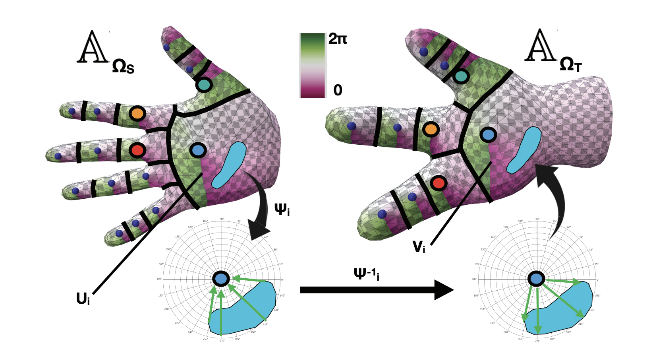
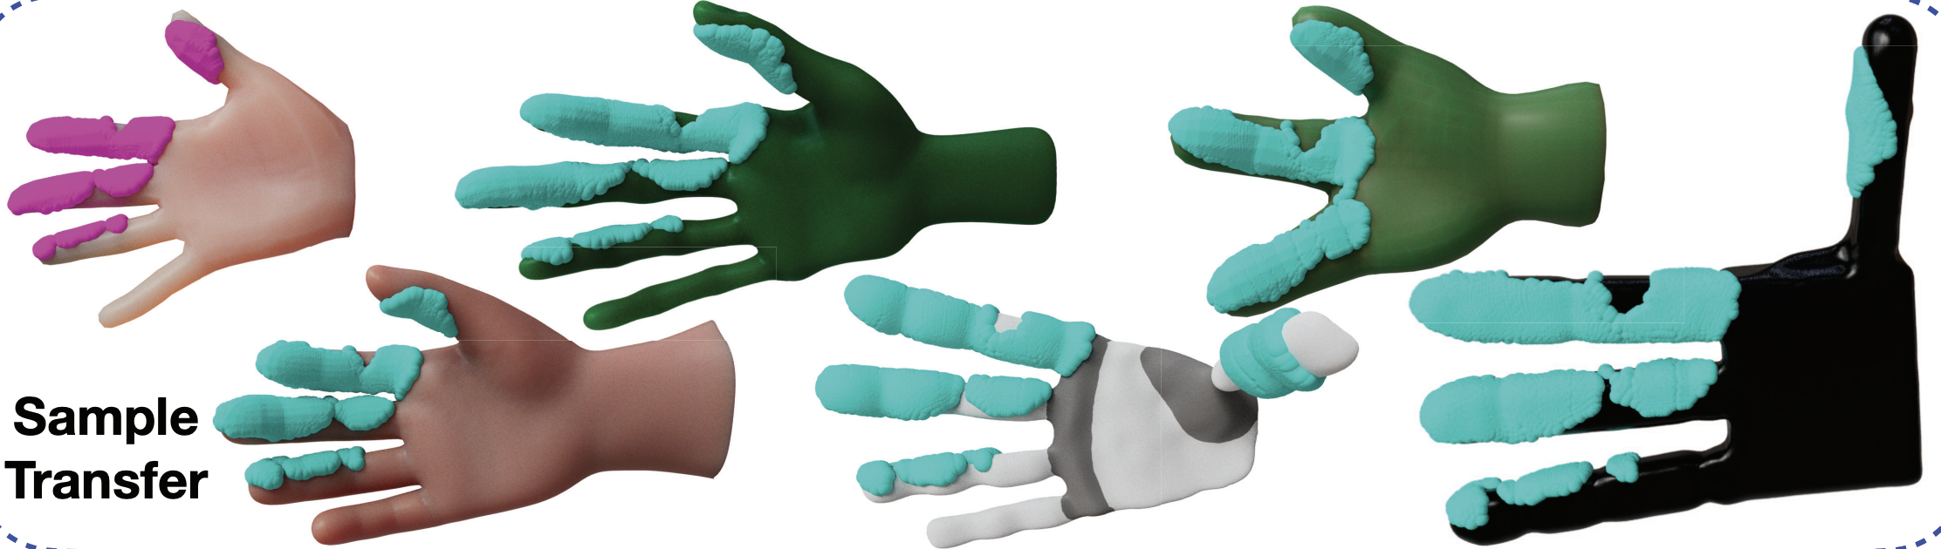
Hand Shape Matching
Inputs of Contact Alignment
Source hand dense contact
Axis curves (artist-provided) on each finger/palm
Landmarks (auto-sampled)
Process
hand surface divided into local charts via landmarks
each contact mapped to nearest landmark
Logmap: project contact to tangent space (r, θ relative to landmark)
Expmap: reconstruct contact on target chart
Nonisometric scaling:
λa = finger length ratio
λs = finger thickness/shape ratio

Slide 8
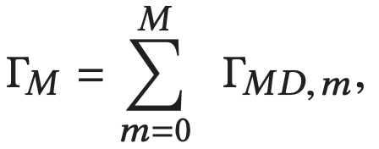
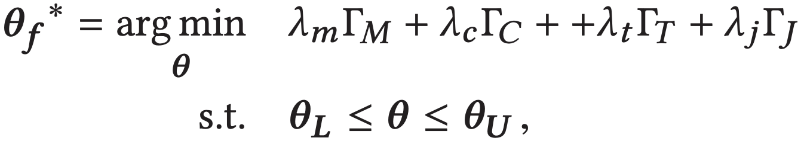
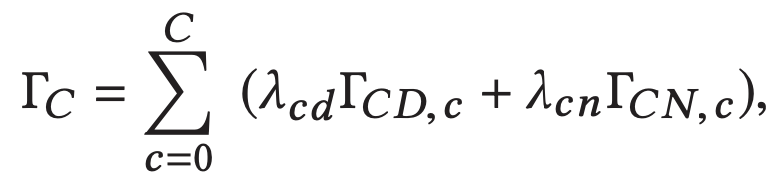
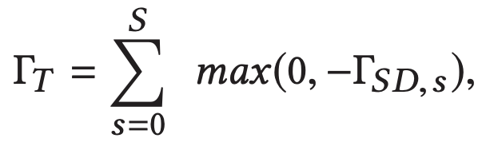
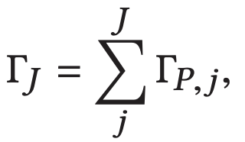
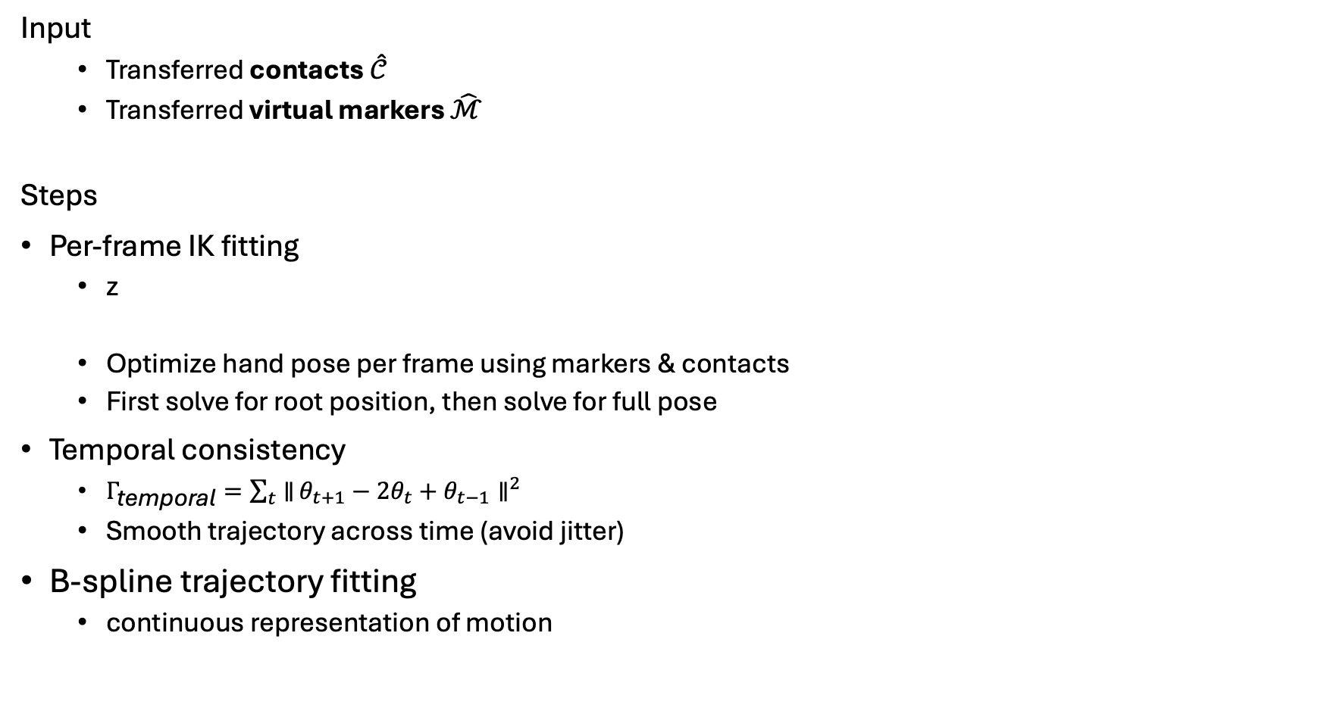
Motion Retargeting
Input
Transferred contacts $\hat{𝒞}$
Transferred virtual markers $\hat{ℳ}$
Steps
Per-frame IK fitting
z
Optimize hand pose per frame using markers & contacts
First solve for root position, then solve for full pose
Temporal consistency
$Γ_{\text{temporal}}=\sum_{t}{∥}θ_{t+1}−2θ_{t}+θ_{t−1}∥^{2}$
Smooth trajectory across time (avoid jitter)
B-spline trajectory fitting
continuous representation of motion
Marker distance
Contact distance
table penalty
Prior penalty

Slide 9
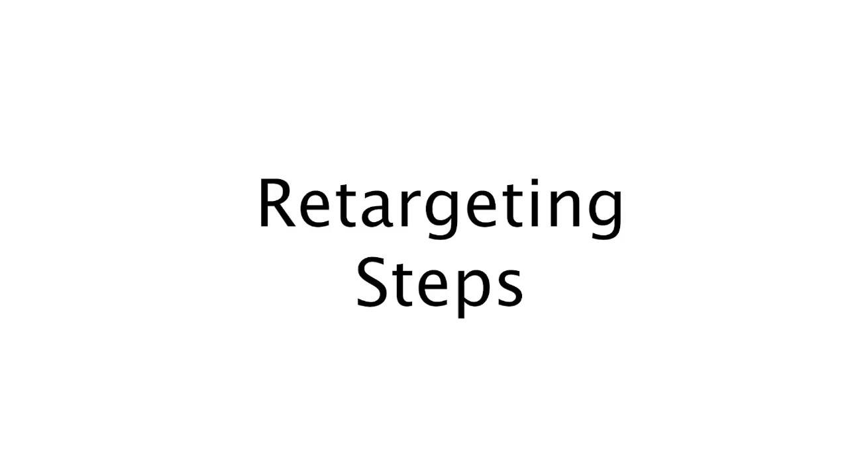

Slide 10
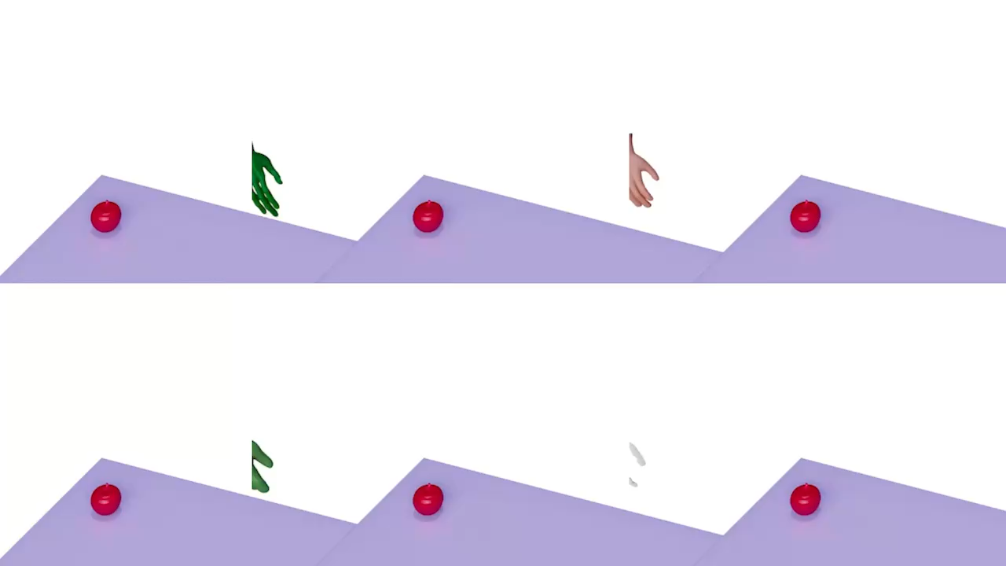
Result

Slide 11
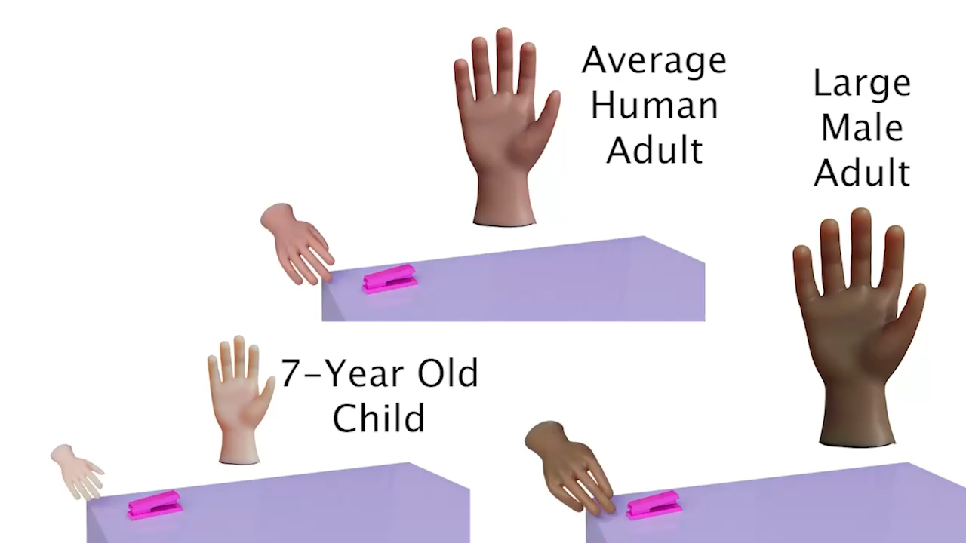

Slide 12
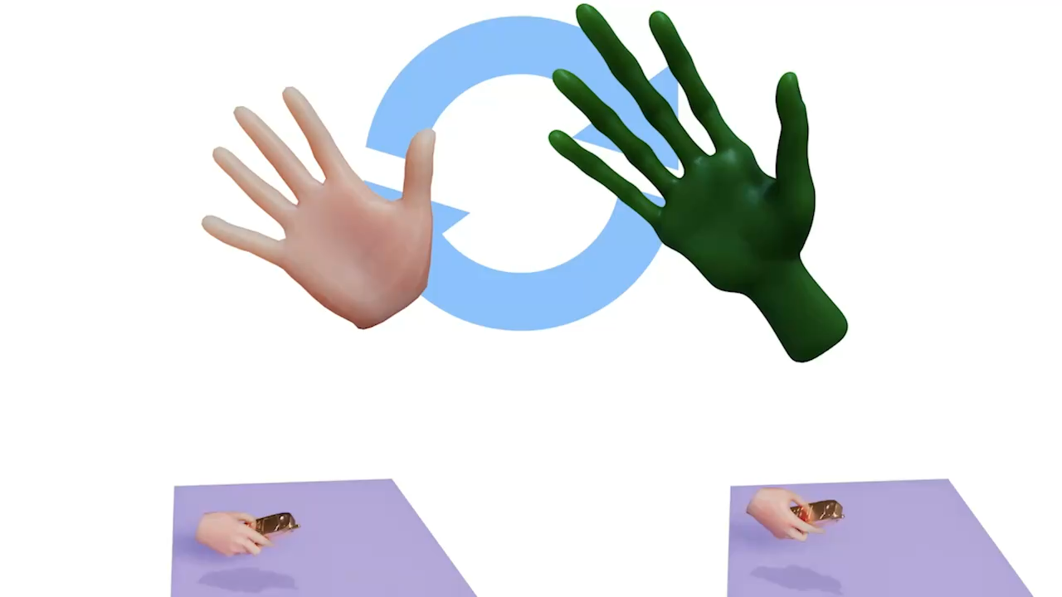

Slide 13
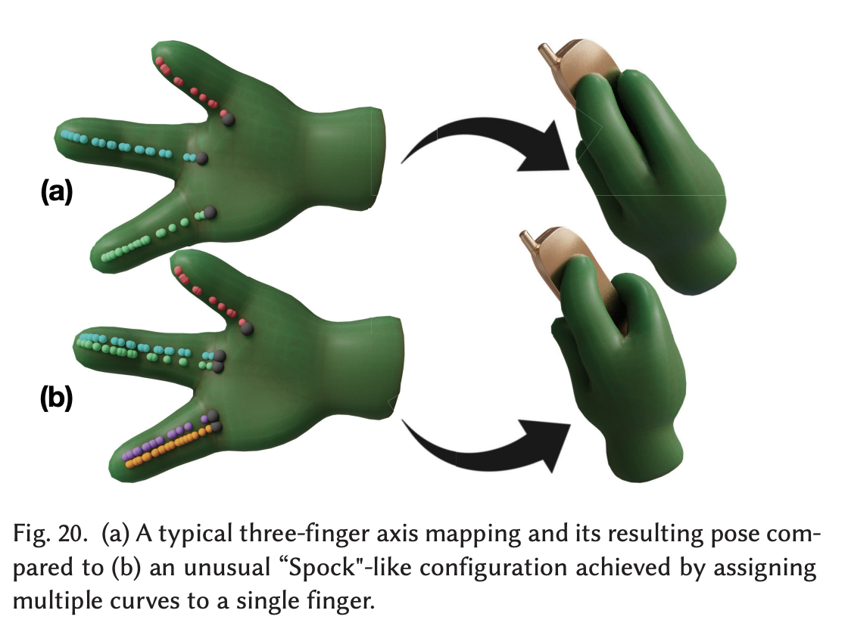
Design Choice Impact

Slide 14
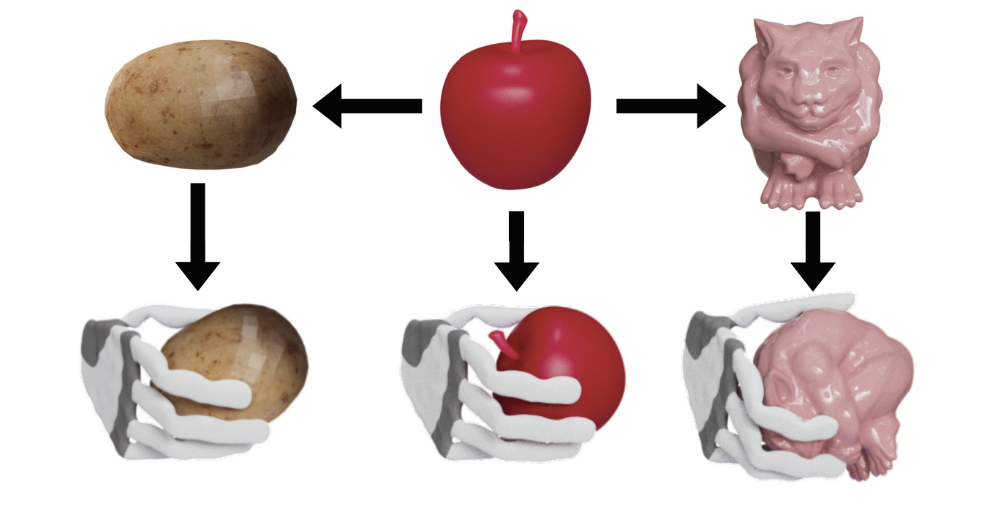
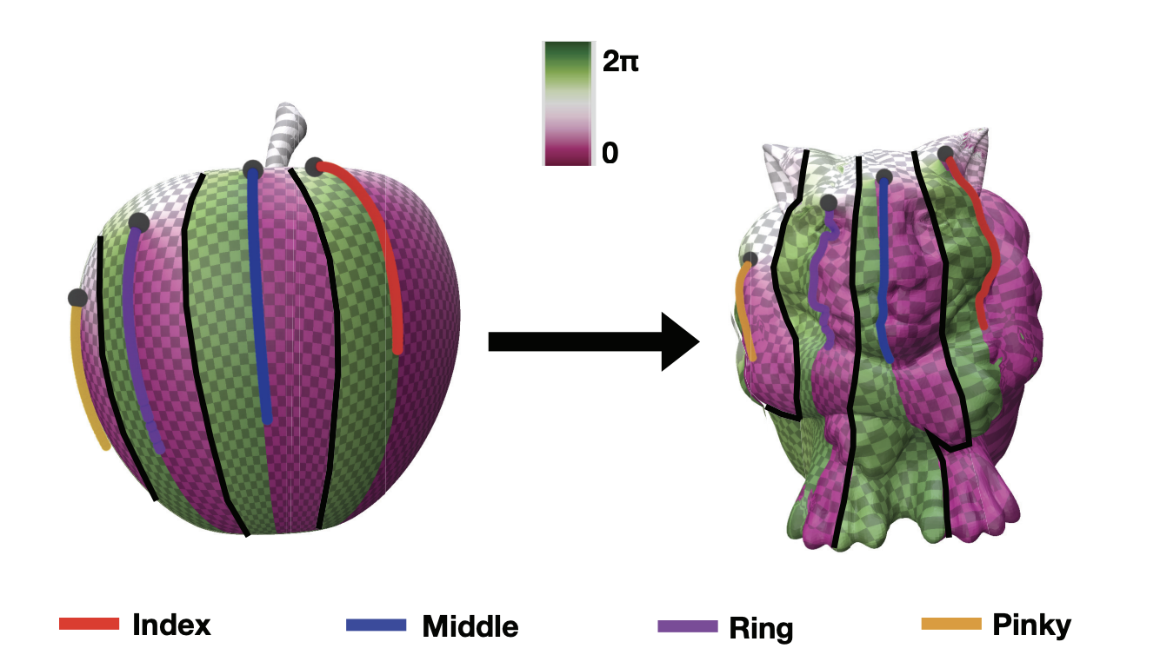
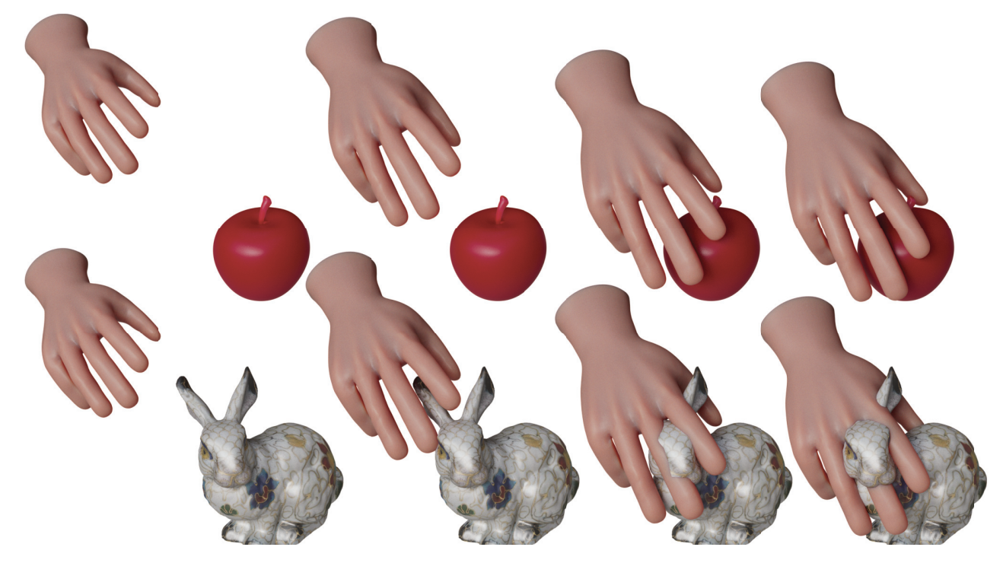
Object Substitution
Contact retargeting using axis curves

Slide 15
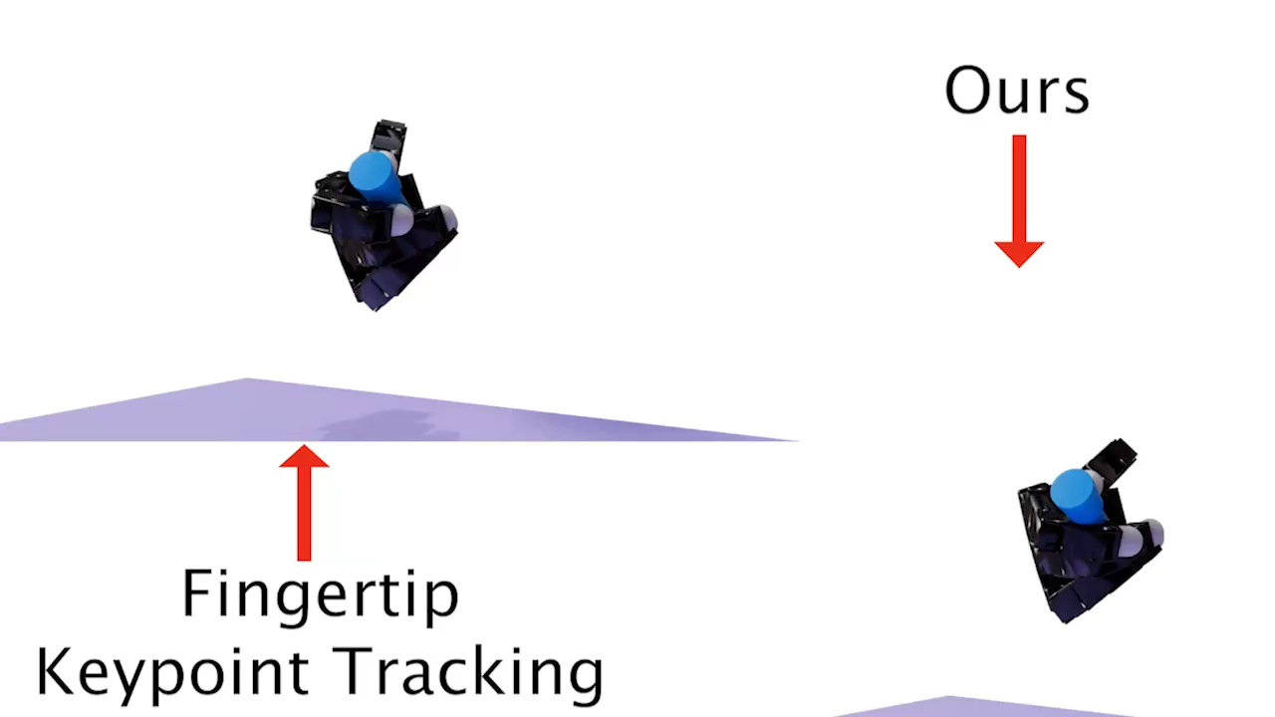
Comparison

Slide 16
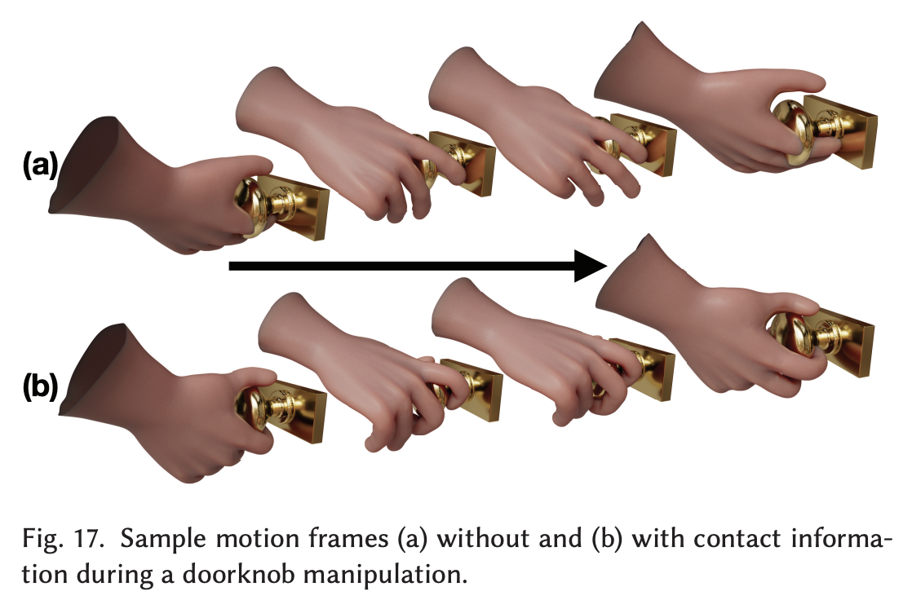
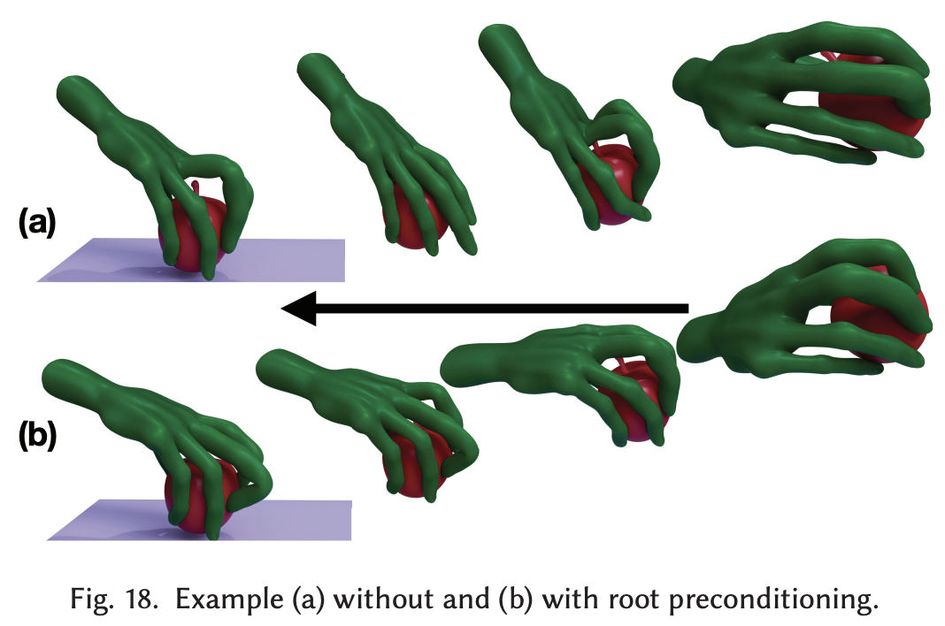
Ablation

Slide 17
Limitation
Naturalness of Table Interactions
Without contact data on the table, retargeted motions sometimes deviate from human-like standards.
Object Substitution Conflicts
Significant object changes can cause contradictions between marker constraints and contact constraints.
Morphological or Kinematic Differences
The method struggles when source and target hands differ greatly in shape or degrees of freedom.
High Computation Cost
Runs only on CPU; each trajectory requires several hours to generate.

Slide 18
Takeaway
Joint Motion–Contact Generation as a Dual Representation
In hand motion generation or dexterous transfer learning, producing not only joint trajectories but also contact distributions provides a richer supervisory signal. Contacts can serve as an additional constraint in the post-processing stage, enhancing physical plausibility and ensuring more realistic hand–object interactions.
B-Spline Smoothing for Physically Coherent Dynamics
Leveraging B-spline fitting to smooth position, velocity, and acceleration yields trajectories with higher temporal consistency. This improves naturalness and stability in generated motions, making them more suitable for both motion generation and dexterous transfer learning tasks.

Slide 19
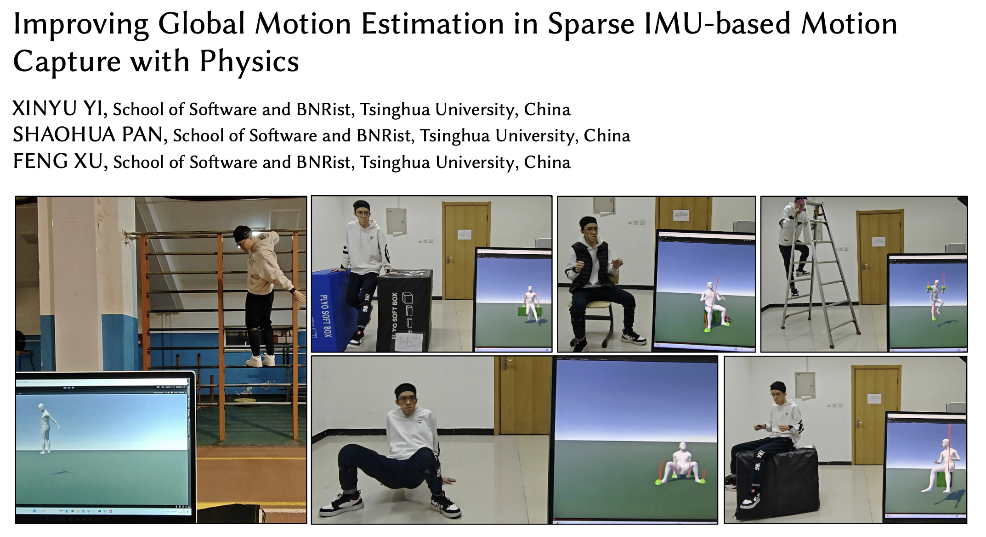

Slide 20
Background of Motion Capture Systems
Types of Motion Capture Systems Vision-based
Marker-based: Tracks 3D markers → high accuracy, but expensive, requires studio setup.
Markerless: Uses 3D point clouds / triangulated keypoints → no markers needed, but occlusion-sensitive and environment-dependent.
IMU-based
Uses accelerometer, gyroscope, gravity, and orientation fusion.
No occlusion, portable, low-cost; but noisy signals, drift accumulates over time.
Challenges in Sparse IMU MoCap
Global pose must be reconstructed from local IMU signals, which is inherently ambiguous.
These signals are often noisy due to sensor bias, vibration, and sparse placement.
Errors accumulate over time.

Slide 21
Related Work
Enhancing Global Pose
Extra sensors (camera, UWB):
Improve accuracy by reducing ambiguity,
but the need for additional devices limits flexibility and applicability.
Physics-based constraints:
Reduce drift and unnatural motion,
but often rely on flat-plane assumptions (feet contact) , unsuitable for complex motions and diverse environments.
Solution:
Estimate 3D contacts directly from IMU signals.
Full 3D physics-based optimization, beyond feet-ground contact.

Slide 22
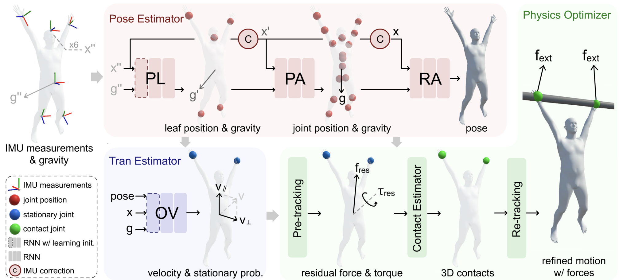
Pipeline
Input: 6 IMUs (accelerations, angular velocities, orientations)
Output: Human pose, global motion, and physical quantities (contacts, forces, torques, proxy surfaces)

Slide 23
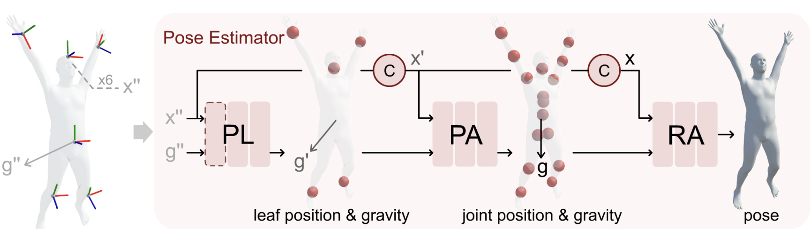
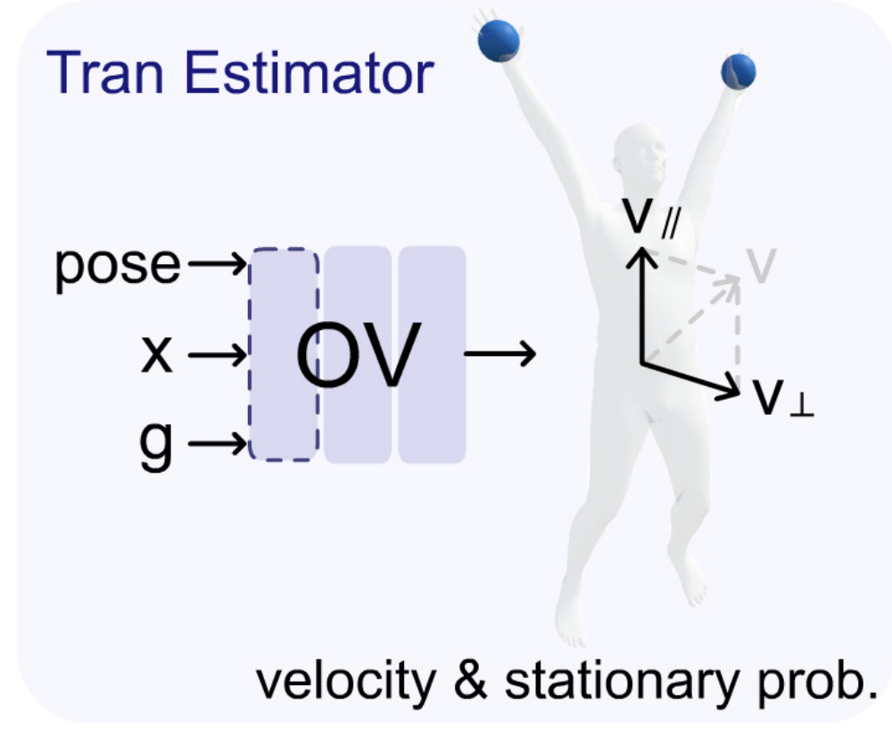
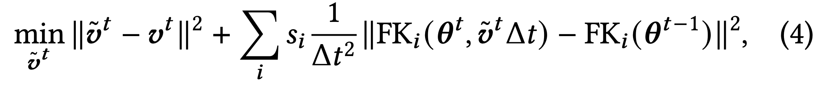
Local Pose & Global Translation Estimation
Pose Estimator
Estimate leaf joints + gravity direction
Refine IMU signals using gravity
Estimate all joints with refined signals
Regress SMPL pose (full body)
Translation Estimator
Estimate
Root velocity (parallel & perpendicular to gravity)
Stationary joint probabilities
Optimization:
a
Refine velocity while keeping stationary joints fixed

Slide 24
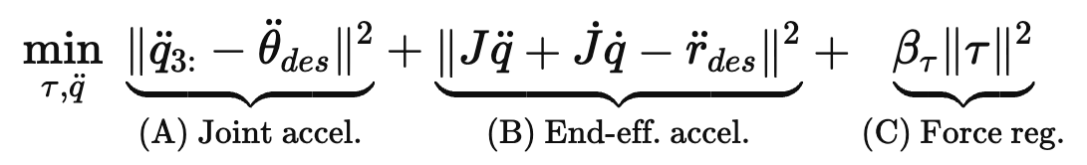

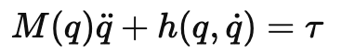
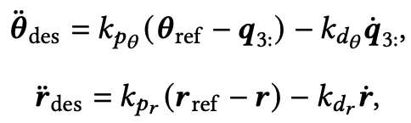
Physics Optimizer
Pre-tracking
Contacts are unknown
Goal: Calculate how much residual force is needed for tracking the reference motion
Residual force: the virtual force/torque applied at the root joint to compensate for missing contacts
Objective
Desired accelerations are calculated by PD controller of the physical character

Slide 25
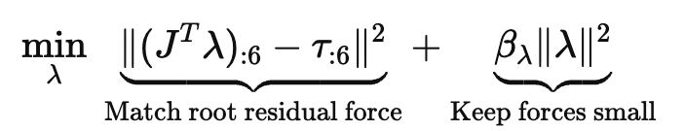
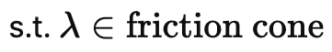
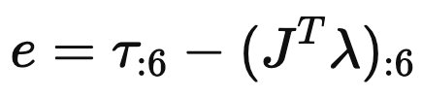
Contact Estimation
Goal: explain the residual force by assigning physical contacts
Rules for selecting contact joints:
A joint is marked as contact if: (a) it is estimated to be stationary, and; (b) either contact in the previous frame or currently touching the ground
If two stationary joints are close to each other and at the same height, and one is contact → mark the other as contact as well
Any stationary joints not marked as contact are labeled as potential contact joints.
Friction Constraints:
Feet & pelvis: contact forces constrained by a friction cone, with surface normal toward the negative gravity direction.
Hands: no friction cone constraint (hands can grasp arbitrary objects)
How current contact set explain residual force:
Check residual force:
If $∣e∣$> threshold → add more candidate joints from If $∣e∣$> threshold → add more candidate joints
If $∣e∣$≤ threshold → accept current contact set

Slide 26
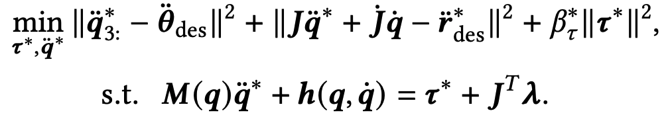
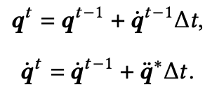
Re-tracking
Contact is known, no need residual force
Goal: refine motion using the estimated contact joints and forces
Update reference positions for contact joints
If above ground (within threshold) → gradually pull down
If penetrating → set to ground level
Objective:
The refined pose:

Slide 27
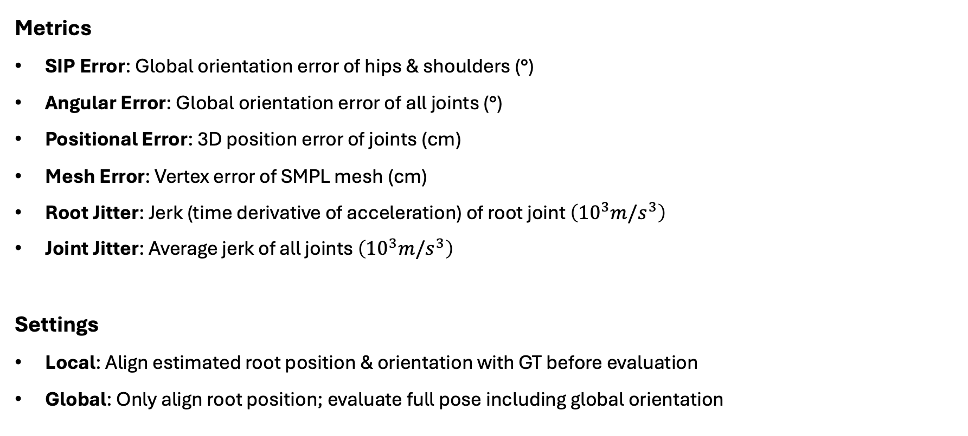
Experiment
Metrics
SIP Error: Global orientation error of hips & shoulders (°)
Angular Error: Global orientation error of all joints (°)
Positional Error: 3D position error of joints (cm)
Mesh Error: Vertex error of SMPL mesh (cm)
Root Jitter: Jerk (time derivative of acceleration) of root joint $\left({10}^{3}m/s^{3}\right)$
Joint Jitter: Average jerk of all joints $\left({10}^{3}m/s^{3}\right)$
Settings
Local: Align estimated root position & orientation with GT before evaluation
Global: Only align root position; evaluate full pose including global orientation

Slide 28
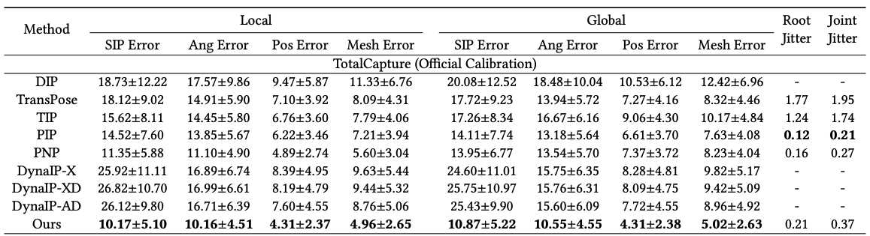
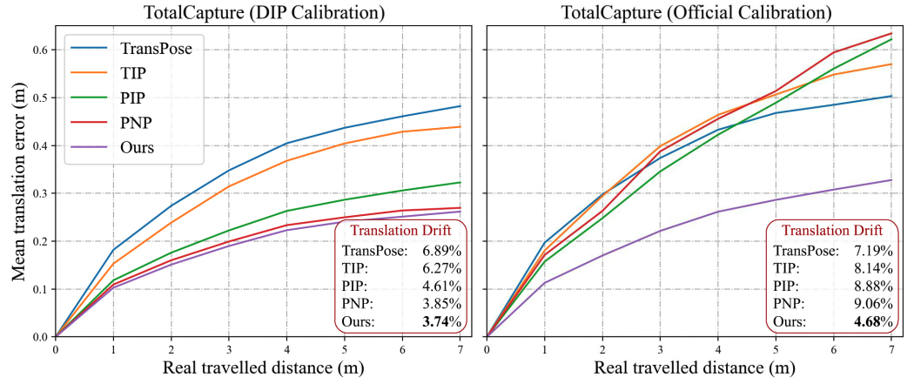
The method achieves higher pose accuracy (local & global) and lower drift in unconstrained 3D space, while maintaining comparable (but not superior) smoothness compared to flat-ground physics-based baselines.

Slide 29
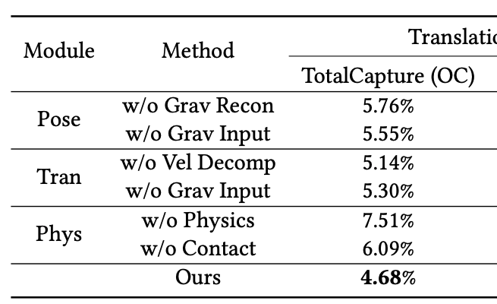
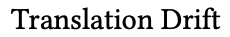
Ablation
Ablation Conclusions
Gravity alone cannot improve performance — it must be refined to reduce noise.
Velocity decomposition and Physics-based optimization are essential for reducing translation drift.

Slide 30
Limitation
Restricted contact joints
Only considers hands, feet, and pelvis
cannot handle other contacts (e.g., leaning head on wall).
Simplified contact assumptions
Proxy surfaces assumed horizontal
Sliding or very light contacts hard to detect.
Ambiguity in multi-contact forces
Multiple valid solutions; resolved only by regularization → tends to evenly distribute forces.

Slide 31
Takeaway
Gravity-aware velocity decomposition
Decomposing velocity into gravity-parallel and orthogonal components effectively mitigates errors along the gravity direction.
3D contact estimation
Contact detection constrains translation drift, but remains unreliable for sliding or light-touch interactions.
Physics-driven character model
Incorporating a physics-based character with torque control suppresses unnatural jitters and enhances motion plausibility.

